Slide 1
Single Table Queries: Aggregations
4.2

Slide 2

SQL Select Query Basics
WHAT data do I want to retrieve?
WHERE is that data stored?
WHICH records do I want?
WHAT and WHERE are required!!

Slide 3
Advanced Filters

Slide 4
SQL Queries: WHICH
Which records do I want to retrieve?
SQL WHICH Keywords
WHERE
=
LIKE
%
NOT LIKE
BETWEEN
IS
DISTINCT
>, >=
<, <=
AND
/* Select title and director from ‘movies’ where title is ‘Toy Story’*/
SELECT title, director
FROM movies
WHERE title = ‘Toy Story’;

Slide 5
SQL Queries: LIKE and %
Finding records with partial matching
LIKE
Partial matches
Uses % as a wild card
/* Select title and director from ‘movies’ where title is LIKE ‘Toy Story’*/
SELECT title, director
FROM movies
WHERE title LIKE ‘Toy Story’;
X
1
How many records are returned?

Slide 6
SQL Queries: LIKE and %
Finding records with partial matching
/* Select title and director from ‘movies’ where title is LIKE ‘Toy Story’*/
SELECT title, director
FROM movies
WHERE title LIKE ‘Toy Story %’;
Toy Story 2
Toy Story 2: Live Action
Toy Story 3
Toy Story 4
Toy Story 5
Toy Story Replayed
A space is a valid character!

Slide 7
SQL Queries: LIKE and %
Finding records with partial matching
/* Select title and director from ‘movies’ where title is LIKE ‘Toy Story’*/
SELECT title, director
FROM movies
WHERE title LIKE ‘Toy Story%’;
Toy Story
Toy Story 2
Toy Story 2: Live Action
Toy Story 3
Toy Story 4
Toy Story 5
Toy Story Replayed
Toy Story: The Heist

Slide 8
SQL Queries: BETWEEN
Searching for values in a range
BETWEEN
Inclusive (finds both named values)
Order matters! (smallest to largest)
✅ BETWEEN 10 AND 13
Includes 10, 11, 12, 13
Includes any decimal value in the range
❌ BETWEEN 60 AND 40
Will return 0 values (not an error)
Must query smallest to largest
/* Select title and director from ‘movies’ where title is LIKE ‘Toy Story’*/
SELECT title, director
FROM movies
WHERE title LIKE ‘Toy Story%’
AND year BETWEEN 1990 AND 1999
Toy Story (1995)
Toy Story 2 (1999)

Slide 9
Sidebar: Dates in Databases
Dates will make you cry
DATE
Date only (YYYY-MM-DD)
TIME
Time only (HH:MM:SS)
TIME WITH TIME ZONE
Time with timezone offset
TIMESTAMP
Date and time without timezone (PostgreSQL)
Date and time, always stored in UTC internally (BigQuery)

Slide 10
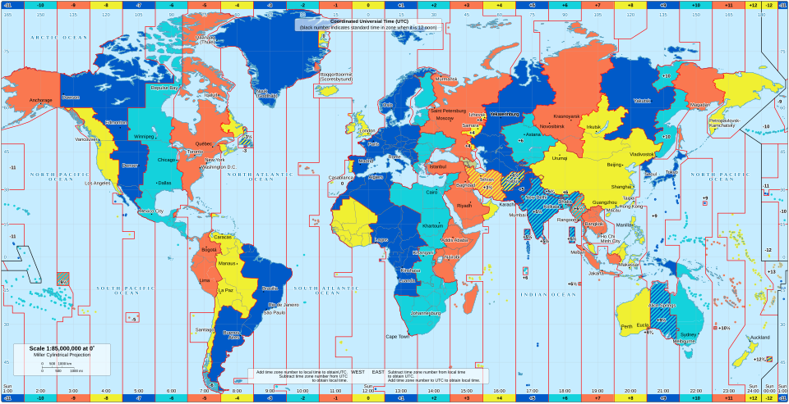

Slide 11
Sidebar: Dates in Databases
Dates will make you cry
DATE
Date only (YYYY-MM-DD)
TIME
Time only (HH:MM:SS)
TIME WITH TIME ZONE
Time with timezone offset
TIMESTAMP
Date and time without timezone (PostgreSQL)
Date and time, always stored in UTC internally (BigQuery)
Date and time, automatically converts to/from UTC and session time zone (MySQL)
TIMESTAMP WITH TIME ZONE
Date and time with timezone (PostgreSQL)

Slide 12
Sidebar: Dates in Databases (UTC)
UTC will make you cry a little less
2024-03-15T19:00:00Z (Z means "Zulu time" = UTC)
2024-03-15T19:00:00+00:00 (explicit UTC offset)
2024-03-15 19:00:00 UTC (with UTC designation)

Slide 13

Querying Dates and Times in BigQuery: Option 1
Be as explicit as possible
/* Select all records from Jan 1, 2000 – March 31, 2000 */
SELECT *
FROM my_table
WHERE sale_date
BETWEEN '2000-01-01 00:00:00 UTC'
AND '2000-03-31 23:59:59.99999 UTC'

Slide 14
Querying Dates and Times in BigQuery: Option 2
Be as explicit as possible
/* Select all records from Jan 1, 2000 – March 31, 2000 */
SELECT *
FROM my_table
WHERE sale_date >='2000-01-01 00:00:00 UTC'
AND sale_date < '2000-04-01 00:00:00 UTC'

Slide 15
SQL Queries: DISTINCT
Finding unique values in a column
Eliminates duplicate rows from query results
Works best with a slim subset of columns
SELECT DISTINCT city
FROM customers
/* If cities are: ['New York', 'Boston', 'New York', 'Chicago', 'Boston'] Result: ['New York', 'Boston', 'Chicago']
*/

Slide 16
SQL Queries: DISTINCT
Finding unique values in a column
Eliminates duplicate rows from query results
Works best with a slim subset of columns
New York, NY
Portland, ME
Chicago, IL
New York, NY
Chicago, IL
Portland, OR
Chicago, IL
SELECT DISTINCT city, state
FROM customers
New York, NY
Portland, ME
Chicago, IL
Portland, OR

Slide 17
Aggregations

Slide 18

SQL Aggregation Queries: WHAT + Calculations
Beginning the transition from data to information
SQL Aggregation Keywords
COUNT
SUM
AVG
MIN
MAX
Aggregations are primarily (not exclusively) for numeric data

